Slide 1

Understanding Information Warfare and Information Operations
Welcome to an exploration of the modern battlefield—one that exists not only in physical space but increasingly in the digital realm. Information warfare represents a fundamental shift in how conflicts are waged, where data, perception, and psychological influence can be as powerful as traditional weaponry. In this presentation, we'll examine how nations and organizations compete for information superiority and defend against evolving threats in our interconnected world.

Slide 2
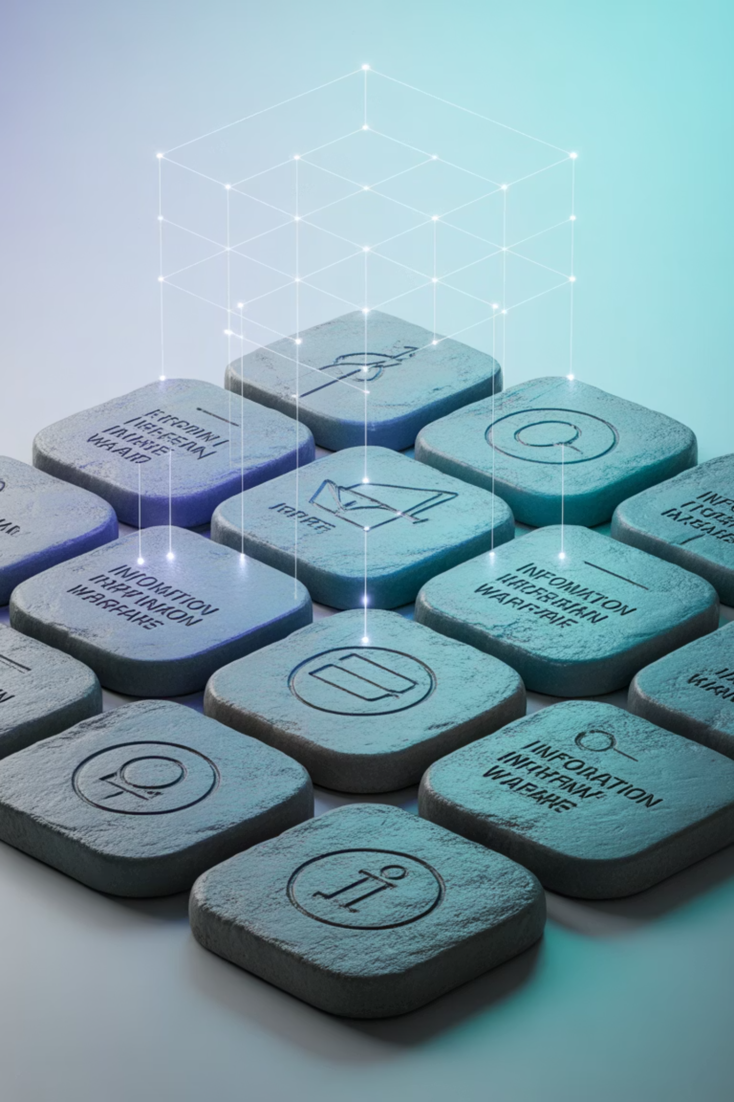
Chapter 1: Foundations of Information Warfare

Slide 3
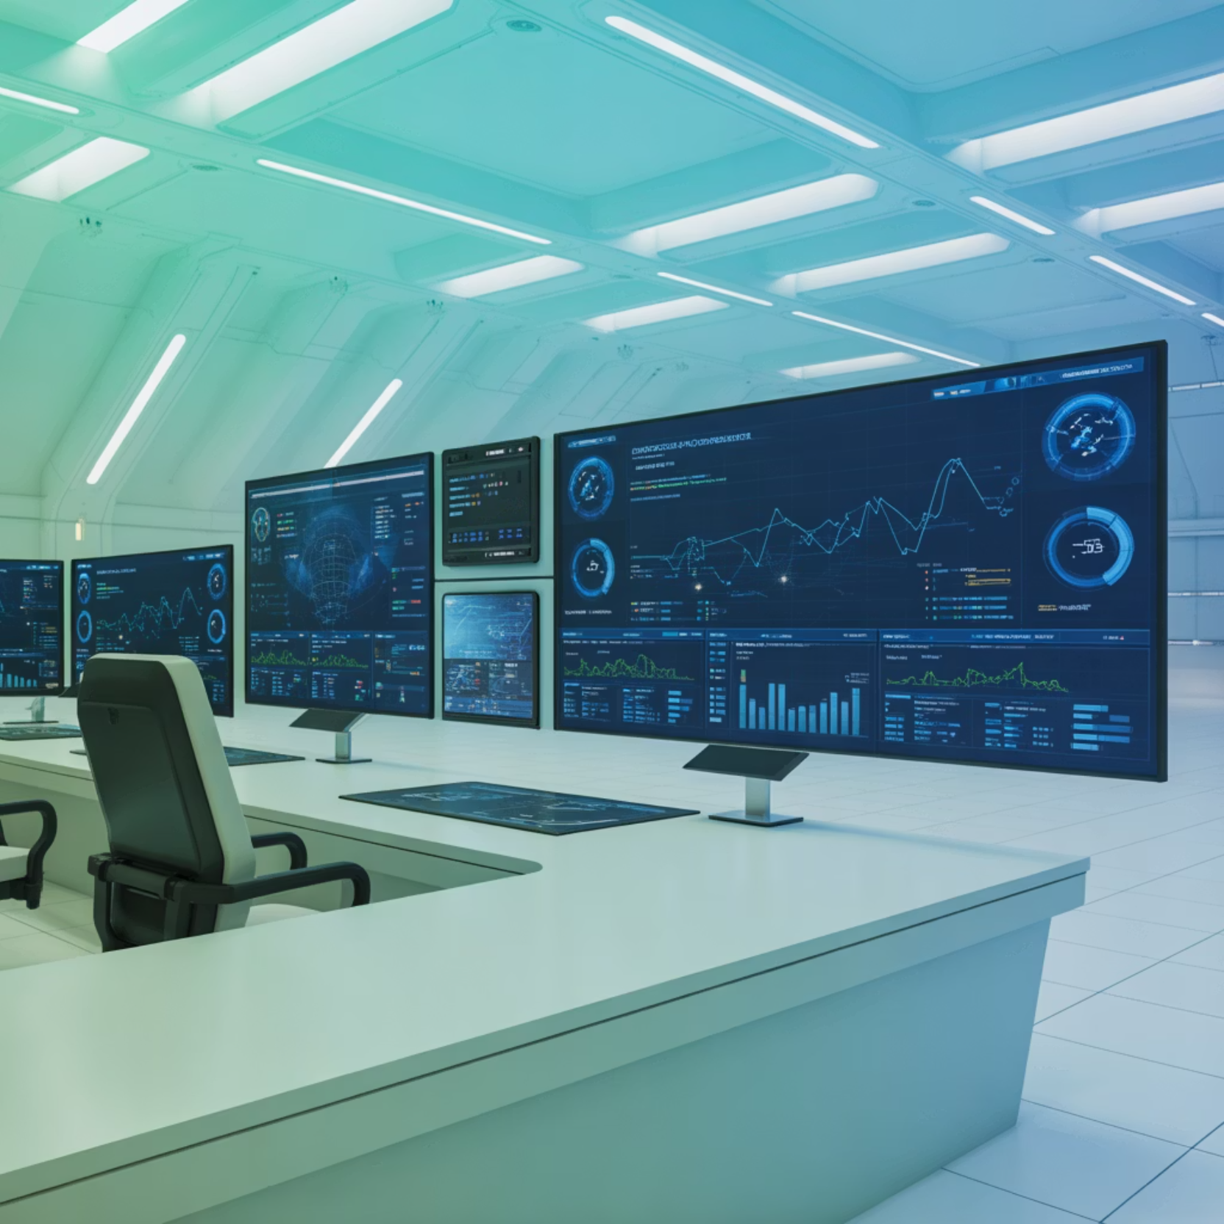
What is Information Warfare?
Information warfare encompasses strategic actions designed to gain information superiority by affecting adversary information systems, processes, and decision-making capabilities while simultaneously protecting our own information infrastructure. This multifaceted domain includes cyber warfare, psychological operations, electronic warfare, intelligence operations, and more.
While the concept of using information as a weapon is ancient—dating back to early military deception and propaganda—the digital age has transformed its scale, speed, and sophistication. Modern information warfare leverages cutting-edge technology to influence outcomes across military, political, economic, and social dimensions.

Slide 4
Key Terms to Know
Information Operations (IO)
Information Warfare (IW)
Information Assurance (IA)
Integrated actions taken to affect adversary information and information systems while defending one's own information capabilities. IO coordinates multiple elements including cyber operations, electronic warfare, and influence activities to achieve strategic objectives.
Information operations conducted during times of crisis or conflict to achieve specific military and political objectives. IW represents the weaponization of information to gain decisive advantage over adversaries on the modern battlefield.
Measures and practices that protect and defend information systems by ensuring their availability, integrity, authentication, confidentiality, and non-repudiation. IA provides the foundation for trusted and resilient information operations.

Slide 5

The Information Environment
The information environment represents the aggregate of individuals, organizations, and systems that collect, process, disseminate, and act on information. This complex ecosystem encompasses multiple interconnected dimensions:
Physical Dimension
Informational Dimension
The tangible infrastructure including networks, computers, satellites, and communication systems that enable information flow
The content and flow of information itself—where and how information is collected, processed, stored, and shared
Cognitive Dimension
How information is perceived, understood, and acted upon by human decision-makers based on cultural, psychological, and experiential factors

Slide 6

The Battlefield is Now the Information Environment
Modern conflict extends far beyond traditional military domains. Today's battles are fought in cyberspace, across social media platforms, through economic systems, and in the minds of populations worldwide. Understanding this evolving landscape is essential for national security and individual awareness.

Slide 7

Chapter 2: Components of Information Warfare

Slide 8


Cyber and Network-Centric Warfare
Cyber warfare involves exploiting computer networks and digital systems to disrupt, degrade, deny, or control adversary capabilities. This domain has become a primary battleground where nations and non-state actors conduct sophisticated operations with global reach.
Common Cyber Warfare Tactics
Network penetration and espionage to steal sensitive data
Distributed Denial of Service (DDoS) attacks overwhelming systems
Malware deployment including viruses, worms, and ransomware
Advanced Persistent Threats (APTs) for long-term infiltration
Historical Example: In the 1990s, Dutch hackers successfully breached U.S. Department of Defense systems and attempted to sell the stolen intelligence data to Iraq, demonstrating early vulnerabilities in networked military infrastructure.

Slide 9

Psychological Operations (PSYOPS)
Traditional Propaganda
Digital Disinformation
Influence Campaigns
Crafted messages disseminated through various media channels to shape perceptions, beliefs, and behaviors of target populations
False or misleading information spread through social media platforms and online channels to deceive and manipulate audiences
Coordinated efforts using multiple tactics and channels to systematically influence emotions, motives, and decision-making
Psychological operations leverage information to influence the emotions, motives, objective reasoning, and ultimately the behavior of adversaries, neutral parties, or target populations. These operations range from strategic communications to sophisticated influence campaigns.
Modern Example: Russian information operations have employed troll farms, bot networks, and fabricated news stories to influence public opinion during the Ukraine conflict and in various election interference campaigns, demonstrating the scale and sophistication of contemporary PSYOPS.

Slide 10

Electronic Warfare and Command & Control Warfare
01
Electronic Attack
Jamming enemy radar, communications, and sensor systems to blind adversary forces
02
Electronic Protection
Defending own systems against enemy jamming and interference through frequency hopping and encryption
03
Electronic Warfare Support
Intercepting and analyzing enemy signals to gather intelligence on capabilities and intentions
04
Command & Control Disruption
Targeting decision-making processes by degrading communications between command elements and operational units
Electronic warfare targets the electromagnetic spectrum to control the battlespace, while command and control warfare aims to degrade an adversary's ability to effectively command forces and execute operations. These operations create information advantage by denying adversaries situational awareness while maintaining our own.

Slide 11




Economic Information Warfare
Economic information warfare represents the targeting of financial systems, economic transactions, and commercial infrastructure to weaken an adversary's economic foundation and capacity to sustain operations. In our interconnected global economy, electronic financial systems present both opportunities and vulnerabilities.
Financial System Attacks
Cyber operations targeting banking infrastructure, payment systems, and stock exchanges to create economic disruption
Transaction Manipulation
Interference with electronic commerce, trade systems, and financial data to undermine economic confidence and stability
Economic Coercion
Using information operations to amplify economic pressure, create market instability, and achieve strategic objectives

Slide 12

Chapter 3: Cognitive and Psychological Dimensions

Slide 13






Cognitive Warfare: The New Frontier
Cognitive warfare represents an evolution beyond traditional information operations, directly targeting how individuals and populations think, perceive reality, and make decisions. By combining insights from neuroscience, behavioral psychology, and digital technology, cognitive warfare seeks to shape the fundamental cognitive processes that drive human behavior.
This emerging domain weaponizes information to exploit cognitive biases, manipulate perception, and influence decision-making at both individual and societal levels. Unlike kinetic warfare that targets physical assets or cyber warfare that targets digital systems, cognitive warfare targets the human mind itself.
Target Selection
Identify vulnerable populations and decision-makers
Analysis
Study cognitive biases and psychological vulnerabilities
Message Crafting
Develop tailored narratives exploiting identified weaknesses
Dissemination
Deploy content through optimal channels and amplifiers
Impact Assessment
Measure behavioral changes and refine approach
Real-World Impact: Sophisticated disinformation campaigns have successfully shaped public opinion on critical issues, influenced electoral outcomes, and even incited real-world violence—all by exploiting cognitive vulnerabilities and the viral nature of social media platforms.

Slide 14
Psychological Warfare vs. Psychological Operations
Psychological Warfare
Psychological warfare encompasses the broader strategic concept of all efforts to influence, manipulate, or coerce adversary and neutral audiences' minds, emotions, and behaviors during conflict. It includes propaganda, terror, coercion, and deception across all domains.
Broader scope spanning strategic to tactical levels
May include coercive and manipulative elements
Employed by both state and non-state actors
Can target military forces and civilian populations
Psychological Operations (PSYOPS)
PSYOPS are specific, planned military operations designed to convey selected information and indicators to target audiences to influence their emotions, motives, objective reasoning, and ultimately their behavior in ways that support the achievement of specific military objectives.
Formal military doctrine with defined procedures
Planned operations with measurable objectives
Governed by laws of armed conflict and rules of engagement
Integrated component of military information operations
While closely related, psychological warfare represents the overarching strategic approach, while PSYOPS constitute the specific tactical and operational tools employed within that broader framework. Both leverage understanding of human psychology to achieve objectives without kinetic force.

Slide 15

Winning Minds is Winning Wars
In the 21st century, victory increasingly depends not on controlling territory or destroying enemy forces, but on shaping perceptions, influencing decisions, and winning the cognitive battle for hearts and minds. The most effective weapon may not be a missile, but a carefully crafted narrative that changes how people think and act.

Slide 16

Chapter 4: Defending Against Information Threats

Slide 17






Information Assurance and Security
Information assurance provides the foundational framework for protecting information systems and ensuring they remain reliable, trustworthy, and resilient against diverse threats. Effective IA programs integrate technical controls, policy frameworks, and human factors to create defense-in-depth.
Integrity
Protecting information from unauthorized modification or corruption
Confidentiality
Ensuring information is accessible only to authorized individuals and systems
Availability
Ensuring authorized users can access systems and data when needed
Non-repudiation
Ensuring actions and transactions can be traced to responsible parties
Authentication
Verifying the identity of users, devices, and information sources
Defense Strategies
Layered security architecture with multiple defensive barriers
Continuous monitoring and threat detection systems
Regular security assessments and vulnerability testing
Incident response and recovery capabilities
User training and security awareness programs

Slide 18


Operational Security (OPSEC)
Operational Security is a systematic process for identifying critical information, analyzing threats, assessing vulnerabilities, evaluating risks, and applying appropriate countermeasures to prevent adversaries from exploiting operational capabilities and intentions.
01
Identify Critical Information
Determine what information about operations, if obtained by adversaries, would compromise mission success
02
Analyze Threats
Identify adversaries and their capabilities to collect, analyze, and exploit critical information
03
Assess Vulnerabilities
Evaluate how adversaries could obtain critical information through various collection methods
04
Evaluate Risks
Determine the likelihood and impact of adversary exploitation of vulnerabilities
05
Apply Countermeasures
Implement measures to eliminate or reduce vulnerabilities to acceptable levels
Critical Example: Protecting troop movements, deployment schedules, and operational plans from cyber espionage and human intelligence collection requires robust OPSEC practices. Even seemingly innocuous information like social media posts can reveal patterns that adversaries can exploit.

Slide 19

The Role of Military and Civilian Efforts
Defending against information warfare requires comprehensive integration across military and civilian domains. No single organization can address the full spectrum of information threats—success demands coordinated efforts spanning government, private sector, academia, and civil society.
Cyber Defense Operations
Intelligence Integration
Military and intelligence agencies conduct active defense, threat hunting, and response operations to protect critical networks and infrastructure from sophisticated adversaries
Fusing intelligence from multiple sources to identify threats, understand adversary tactics, and provide early warning of information operations campaigns
Public Affairs & Strategic Communication
Civil-Military Cooperation
Proactive communication to counter disinformation, provide accurate information, and build resilience against influence operations
Partnerships between government, technology companies, media organizations, and educational institutions to share threat information and build societal resilience
Building Public Resilience
Educating citizens to recognize disinformation, verify sources, and think critically about information they encounter is essential. Key capabilities include:
Media literacy and source verification skills
Understanding of common manipulation techniques
Awareness of cognitive biases and echo chambers
Ability to distinguish credible information from propaganda
Healthy skepticism combined with open-minded inquiry

Slide 20

Conclusion: The Future of Information Warfare
Information warfare has become central to modern conflict and national security strategy. The ability to control, manipulate, and defend information across all domains—cyber, cognitive, physical, and social—will increasingly determine outcomes in great power competition and asymmetric conflicts alike.
Societal Resilience
Technological Acceleration
Building resilient societies that can recognize and resist information manipulation while maintaining democratic values and freedom of expression represents the ultimate defense against information warfare
Evolving Threat Landscape
Emerging technologies including deepfakes, synthetic media, and AI-generated content will make distinguishing truth from fabrication increasingly challenging, demanding new detection and verification capabilities
Adversaries continue to develop more sophisticated capabilities leveraging artificial intelligence, quantum computing, and advanced social engineering to conduct information operations at unprecedented scale and speed
Your Role as Students and Citizens
Understanding information warfare is not just academic—it's essential for participating effectively in modern society. As you encounter information online and in media, remember that awareness and critical thinking are your best defenses. Question sources, verify claims, seek diverse perspectives, and resist the comfort of echo chambers. By developing these habits, you become not just informed citizens, but active defenders against information manipulation. The future of information warfare will be shaped by how well societies—including your generation—can balance openness with security, freedom with responsibility, and trust with skepticism.
Peace and stability in the 21st century depend on our collective ability to understand, defend against, and responsibly employ information as both tool and weapon in an increasingly connected world.

